Slide 1
Project NOBLE
Projecting Strikes Against Ukrainian Infrastructure with Markov Transitions
Earp, Mason, Dallas, Ryan
Egl, Hannah Lumpkin, Bree

Slide 2
Notes:
•The full code, all matrices and tables, and answers to the prompted questions can be found in the accompanying Jupyter notebook.
•Claude was used to troubleshoot code, but no code written by Claude was used for the simulation (i.e., code written by Claude for troubleshooting was removed after bugs were identified). Therefore, Claude’s only influence is the adjustment of pre-existing code originally based on Assignment 5 and course content downloaded from the course GitHub.

Slide 3
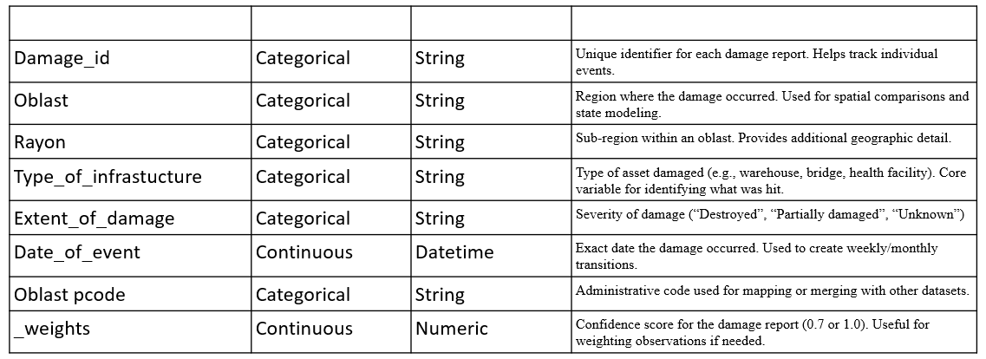
Data Summary
This analysis models the sequence of infrastructure damage in Ukraine. Its not just the volume attacks, but their order and progression overtime , specifically, whether an attack in one location or one type of infrastucture increases the probability of the next attack occuring in another location or on another specific type.

Slide 4
Target Variables
Oblast
Infrastructure Type
Rayon
We are using the oblast of the current damage event to predict the probabilty of where the next damage event will occur. The output isn’t a single location, but a probability distribution accross all possible locations.
Allows us to see patterns within a region
To predict the type of the next target. This allows you to see any attack patterns.

Slide 5
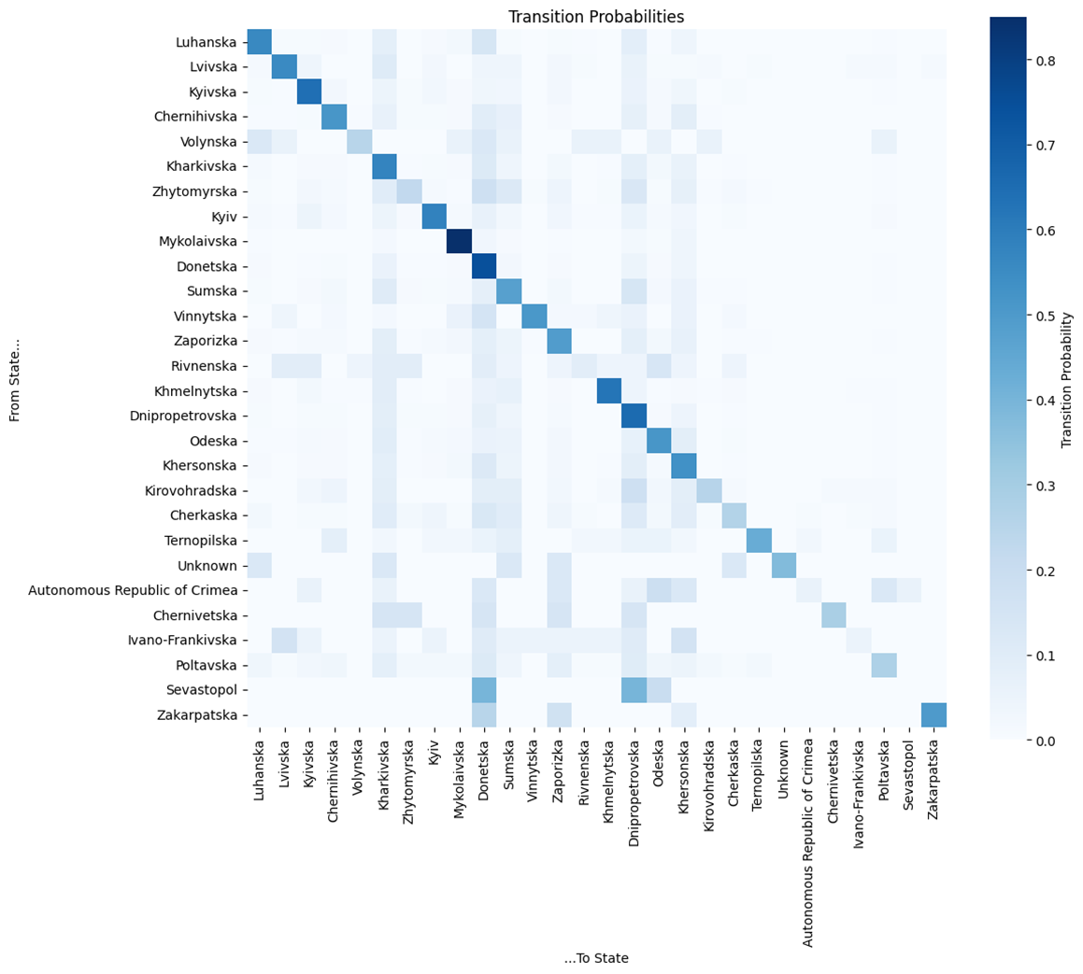
Markov Transition Heatmap

Slide 6
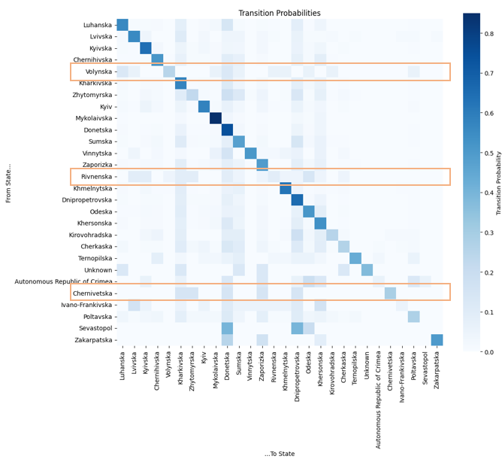
Markov Transition Heatmap
Source of Origin

Slide 7
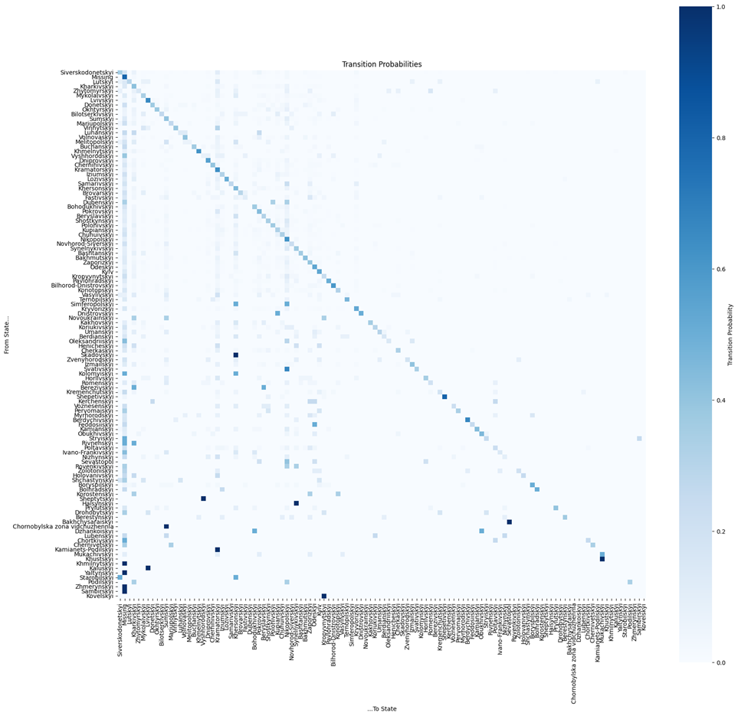

Slide 8
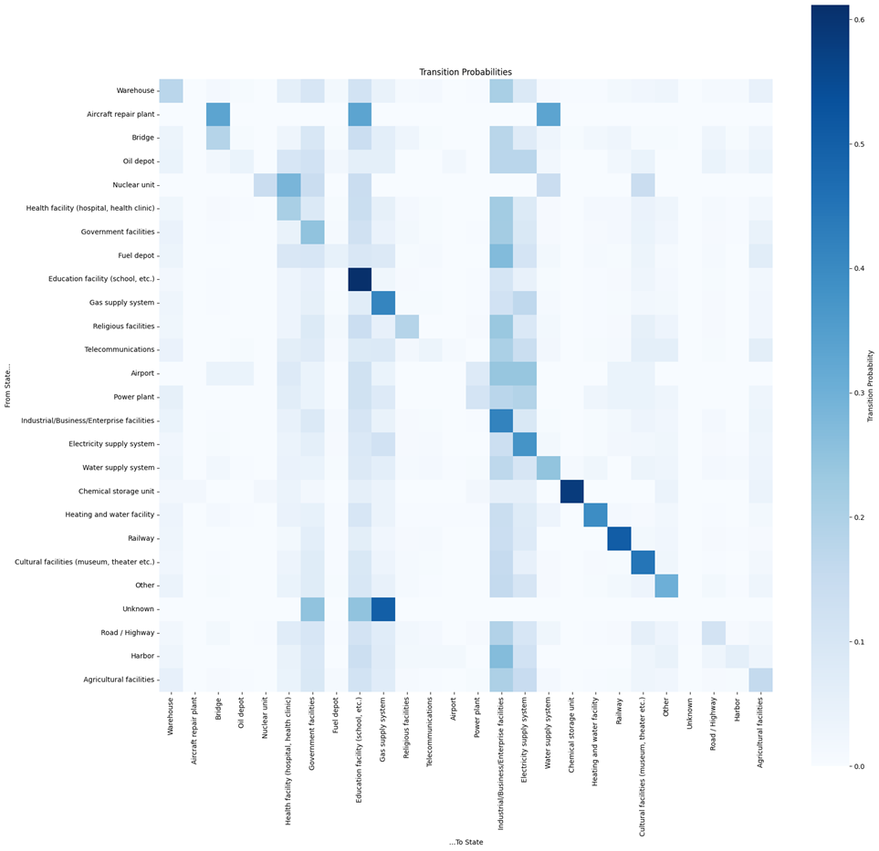

Slide 9
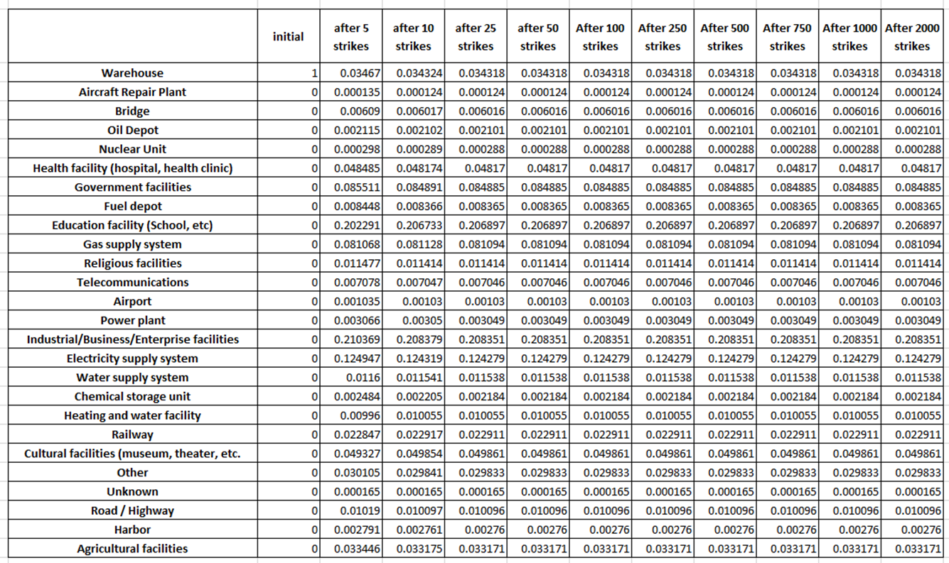
Results

Slide 10
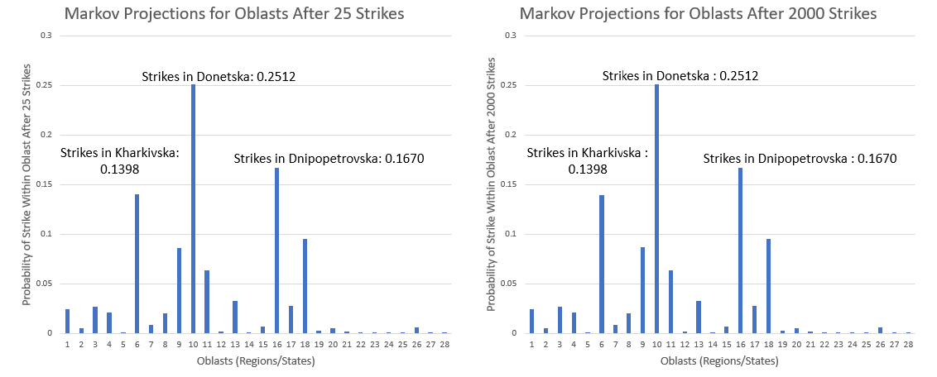
Results (Part 2)

Slide 11
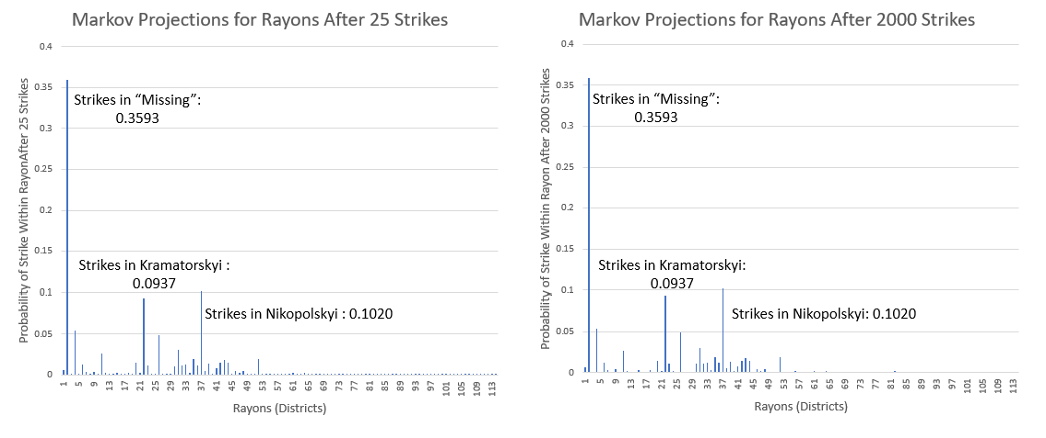
Results (Part 3)

Slide 12
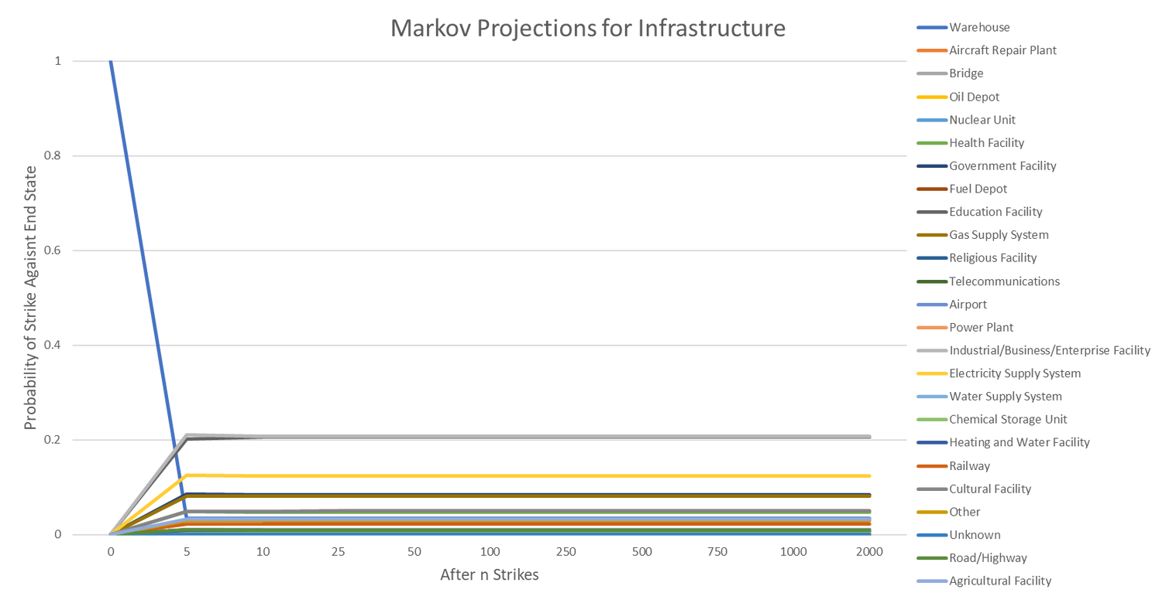
Results (Part 4)

Slide 13
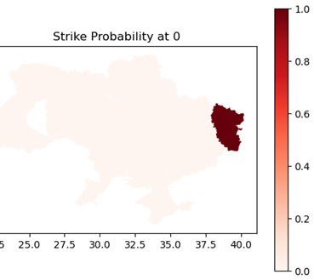
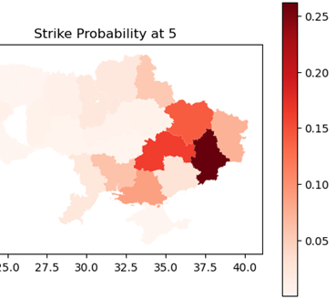
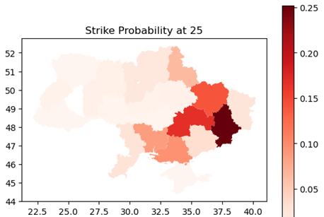
Expansion: GeoData

Slide 14
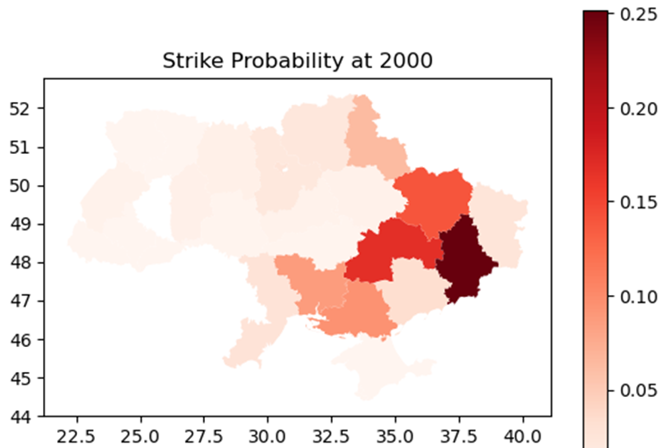

Slide 15
Thank You

